Slide 1
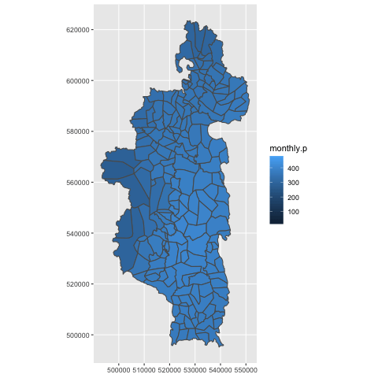

Slide 2
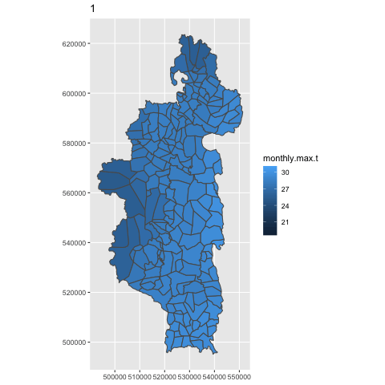
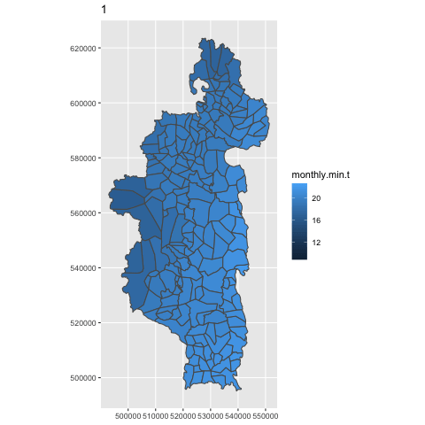

Slide 3
Forest Loss
Forest Cover

Slide 4
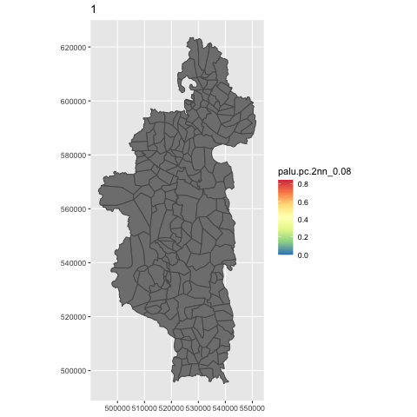

Slide 8
Notes/Ideas
Julie
Clearly some non-linear stuff
Include squared elements AND/OR more complicated formulas (see Erin’s work)
Forest type/cover/loss has a strong effect.
Organize forest loss in a more meaningful way. Eg: loss.year.of, loss.year.before, loss.mean.5years
Population numbers not significant, precipitation not significant

